Slide 1
Discrete Mathematics – Prepositional Logic

Slide 2
Propositional Logic
A proposition is a declarative sentence
they are either always true or always false
2 + 2 = 4 is true
3+2 = 4 is false
Propositions contain no variables
x · 0 = 0 is true, but not a proposition , it contains variable x
The area of logic that deals with propositions is called the propositional calculus or propositional logic.
Propositional logic is the simplest form of logic

Slide 3
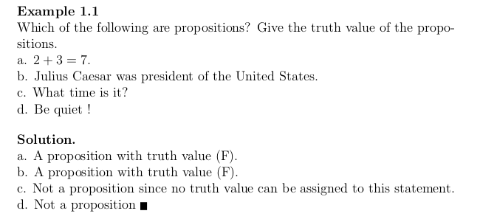

Slide 4
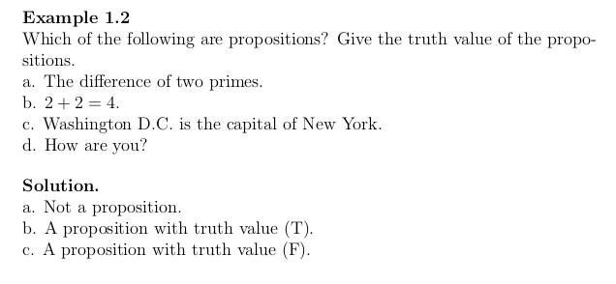

Slide 5
Propositions
A proposition can be represented using letter symbols
p : 2+3 is true.
p is a proposition
q : USA is a country , true
q is a proposition
r : I live in space, false proposition
r is a proposition

Slide 6
S, we know simple sentences which are true or false are basic propositions
We can make new and complex propositions from basic propositions by combining them with connectives.
What are connectives ?
Not, AND, OR, Implies, biconditional implies.

Slide 7
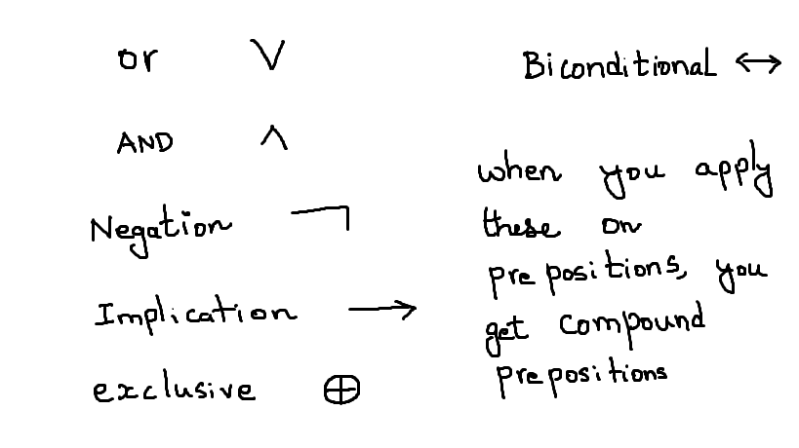
operations on Propositions

Slide 8
Conjunction
Let p and q be propositions.
The conjunction of p and q, denoted by p /\ q, is the proposition "p and q ."
The conjunction p /\ q is true when both p and q are true and is false otherwise.

Slide 9
Disjunction
Let p and q be propositions.
The disjunction of p and q, denoted by p V q, is the proposition
"p or q ." The disjunction p V q is false when both p and q are false and is true otherwise.

Slide 10

Exclusive
Let p and q be propositions. The exclusive or of p and q, denoted by
is the proposition that is true when exactly one of p and q is true and is false otherwise

Slide 11
Combined Proposition
The result of applying these operations on propositions can be summarized using a tables , known as truth tables.

Slide 12
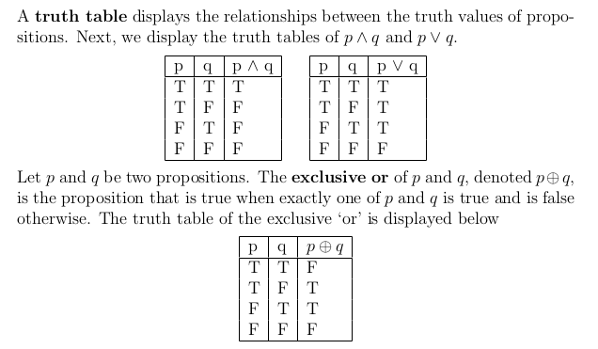

Slide 13
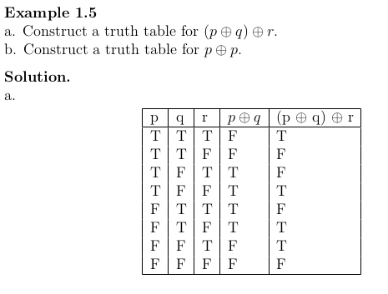

Slide 14
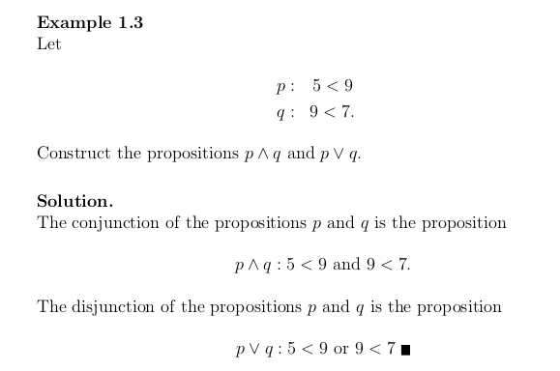

Slide 15
Negation
The negation is a unary operator where operations: or, and, exclusive and implication are binary operators in that they need two propositions to operate on.

Slide 16
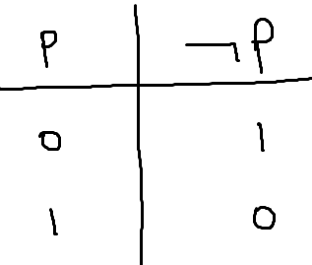
negation

Slide 17
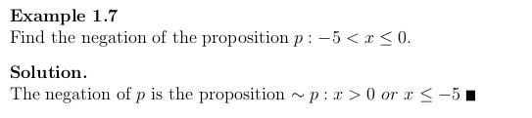

Slide 18
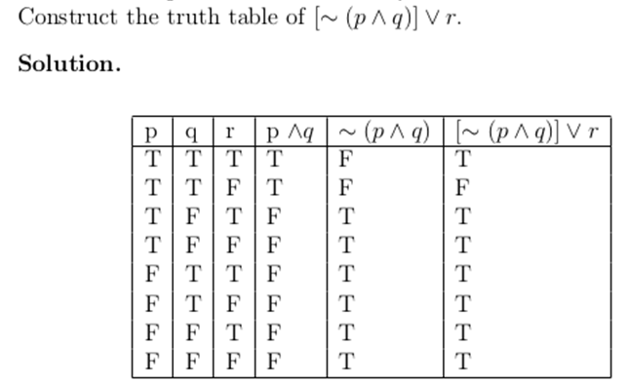
Using Truth Table

Slide 19
Implications
Discrete Mathematics with Proof Eric Gosset , on Implications

Slide 20
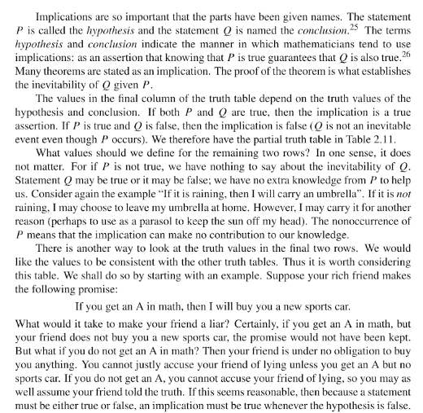

Slide 21
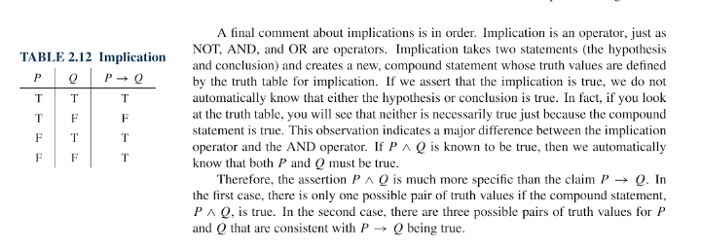
Comment of Implication

Slide 22
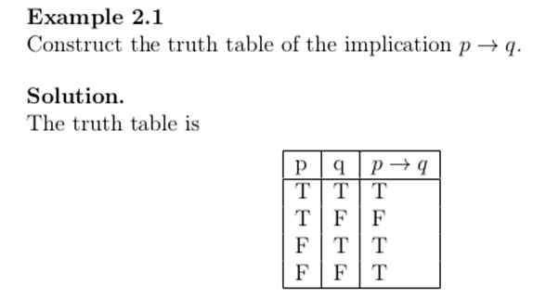

Slide 23
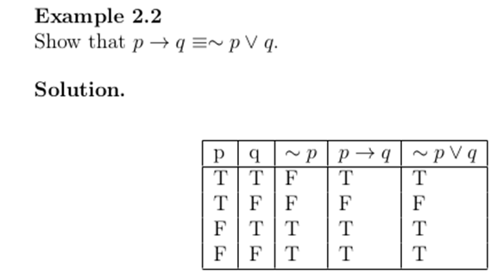

Slide 24


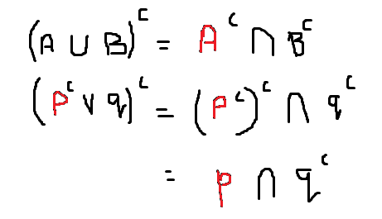

Slide 26
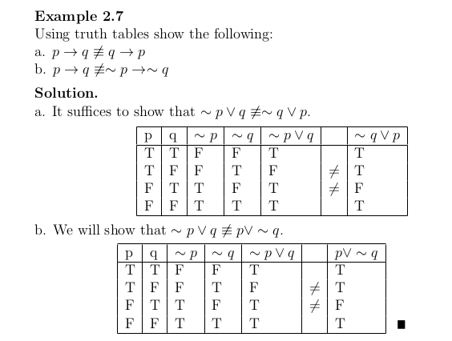
Using Truth Tables

Slide 27
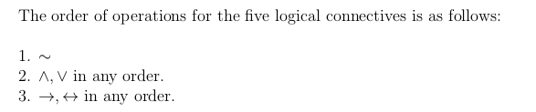
Order of precedence

Slide 28
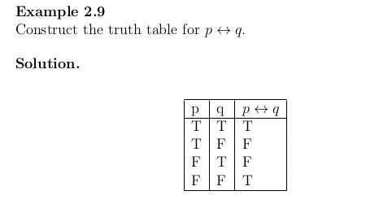

Slide 29
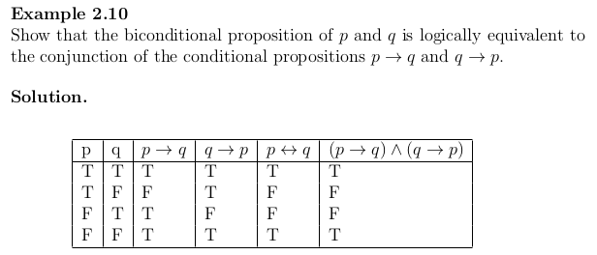

Slide 30
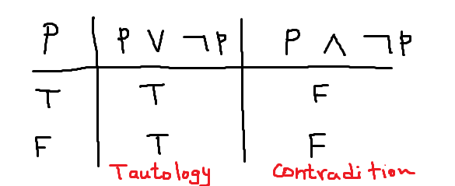
Tautology
A compound statement is true for all its values ie all values in the rows are True, it is tautology
If all the values are false, then it is contradiction

Slide 31
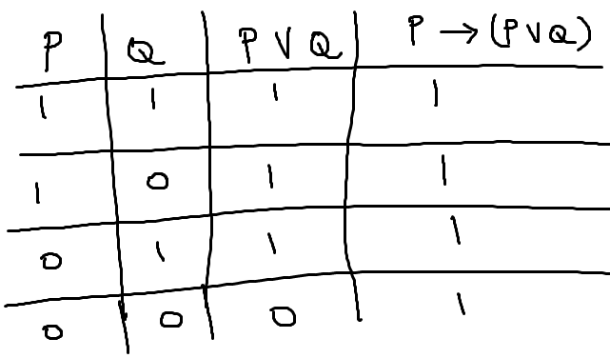
Prove P 🡪 ( P or Q ) is a tautology

Slide 32
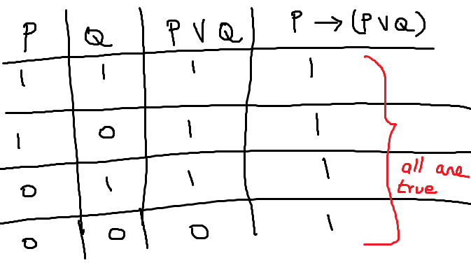

Slide 33
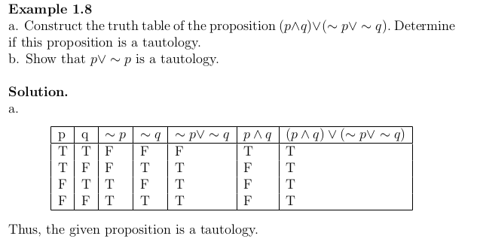

Slide 34
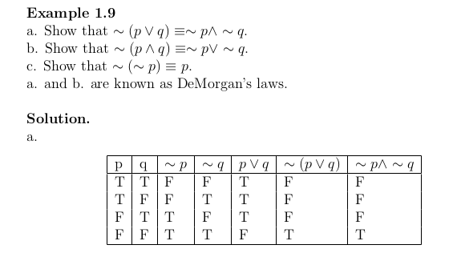

Slide 35
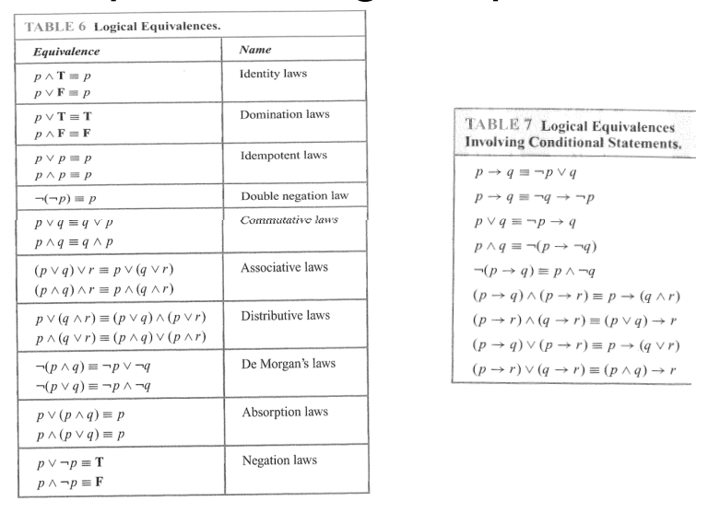

Slide 36
Logical Equivalence
Two statements P and Q are logically equivalent, denoted P = Q, when truth values in ALL rows in the truth tables are the same.

Slide 37
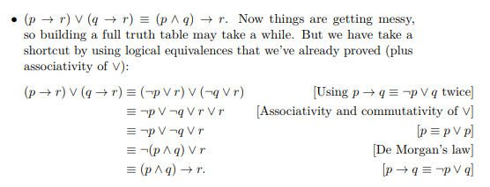
From Yale Professor, Using Logical Equivalence

Slide 38
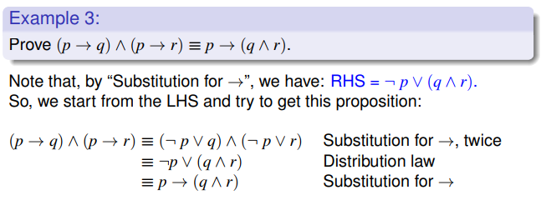
another example Using Logical Equivalence

Slide 39
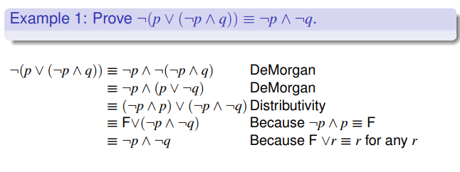

Slide 40
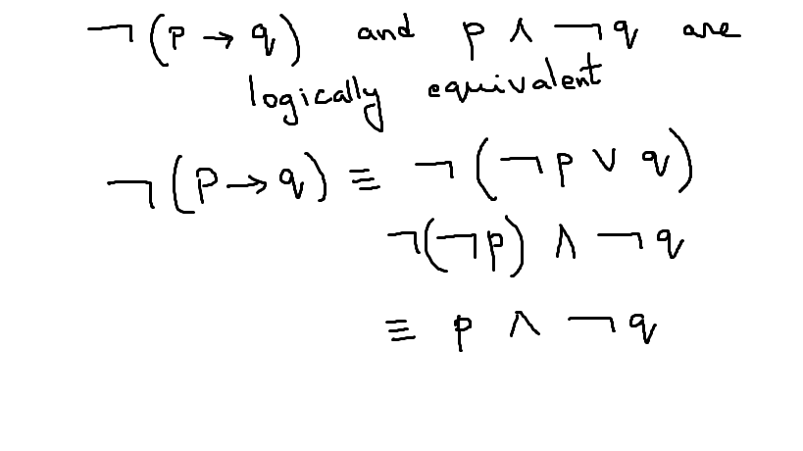
Example

Slide 41
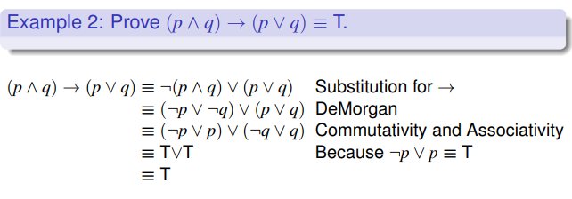
Tautology

Slide 42
Rules of Inferences and Arguments
Arguments in propositional logic is a sequence of propositions.
All the propositions except the final is premises or hypothesis
The final proposition is the conclusion.
The argument is valid if the conjunction of the premises imply the conclusion.
Let P1, P2, P3, …Pn be the propositions and let q be the conclusion.
Then ( P1 /\ P2 /\ P3 /\ ……/\ pn ) -> q is a tautology
We can combine arguments to make complex arguments.

Slide 43
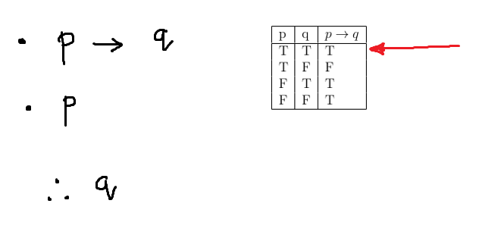
Modus Ponens ( mode by affirmation )

Slide 44
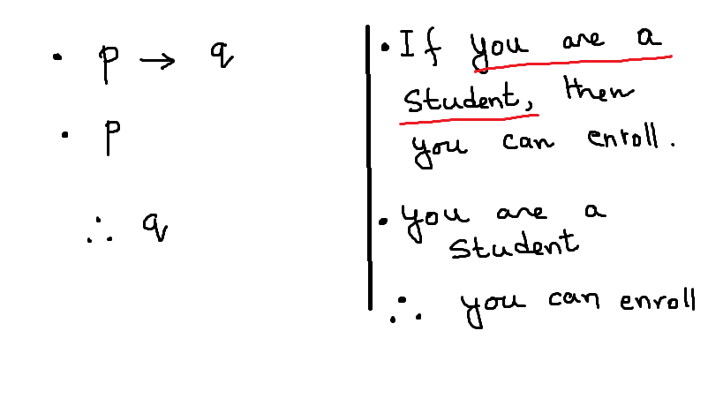
Modus Ponens ( mode by affirmation )

Slide 45
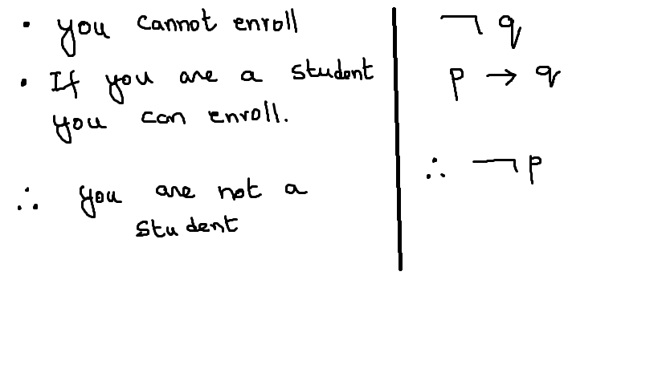
Modus Tollens ( mode by denying)

Slide 46
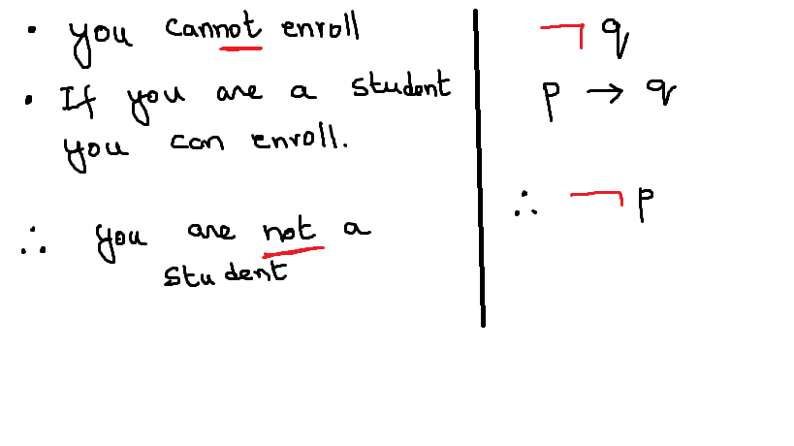
Modus Tollens ( mode by denying)

Slide 47
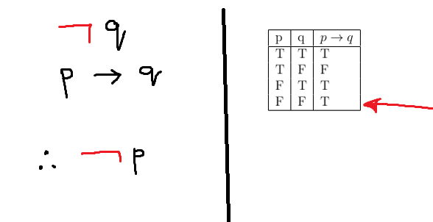
Modus Tollens ( mode by denying)

Slide 48
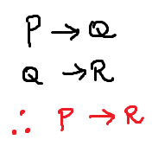
Hypothetical Syllogism – Chain Argument
P | Q | R | P->Q | Q->R | P->Q /\ Q->R
T | T | T | T | T | T
T | F | T | F | T | F
F | T | F | T | F | F
F | F | F | T | T | T
P | R | P->R
T | T | T
T | F | F
F | T | T
F | F | T

Slide 49
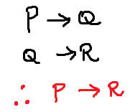
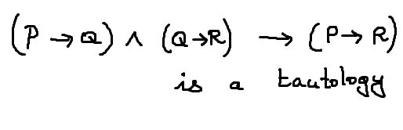
Hypothetical Syllogism – Chain Argument
P->Q /\ Q->R | P->R | (P->Q /\ Q->R) -> (P->R)
T | T | T
F | F | T
F | T | T
T | T | T

Slide 50
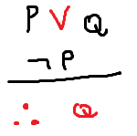
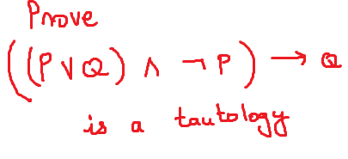
Disjunctive Syllogism
P | Q | P \/ Q | Not P | ( P \/Q ) /\ Not P
T | T | T | F | T
T | F | T | F | T
F | T | T | T | T
F | F | F | T | F

Slide 51
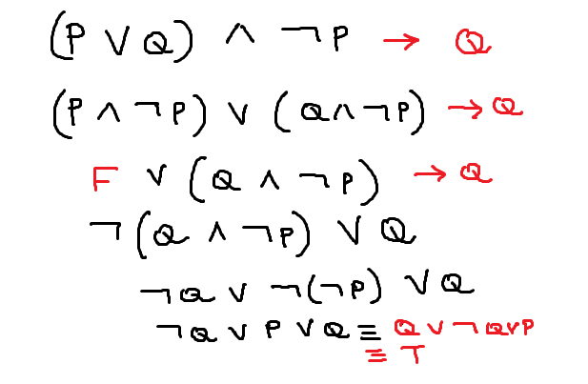
Formal proof of Disjunctive Syllogism

Slide 52
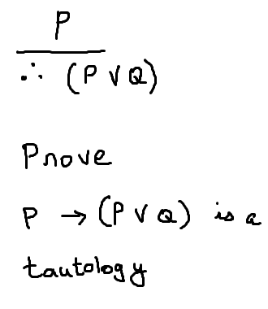
Addition

Slide 53
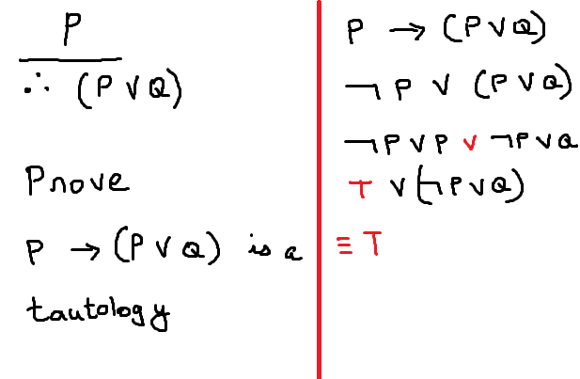
Formal proof of Addition

Slide 54
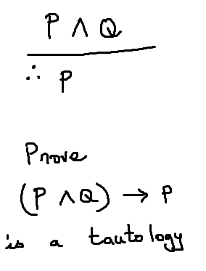
Simplification

Slide 55
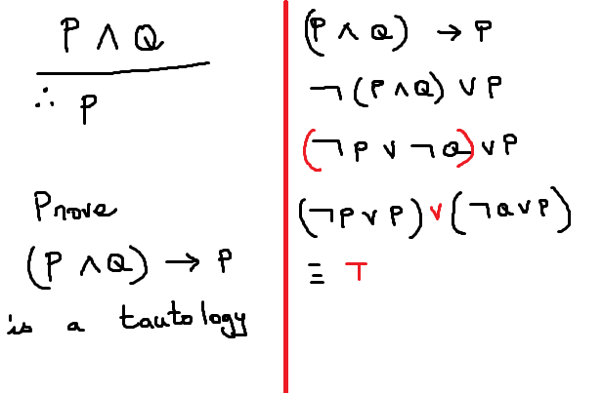
Formal Proof

Slide 56
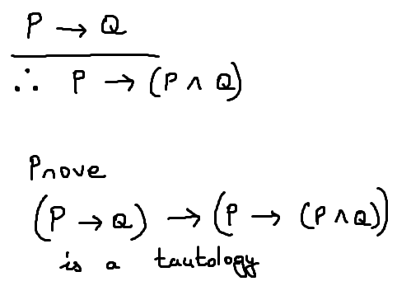
Absorption

Slide 57
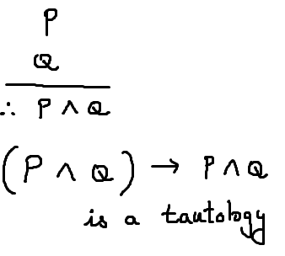
Conjunction

Slide 58
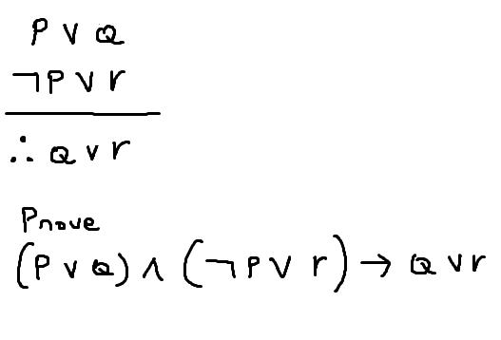
Resolution

Slide 59
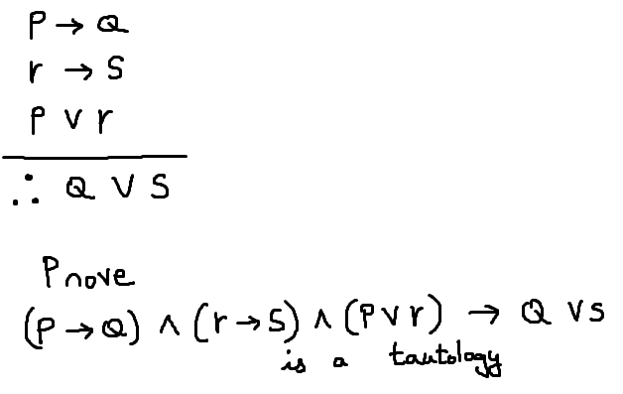
Constructive Dilemma – Disjunction of pollens

Slide 60
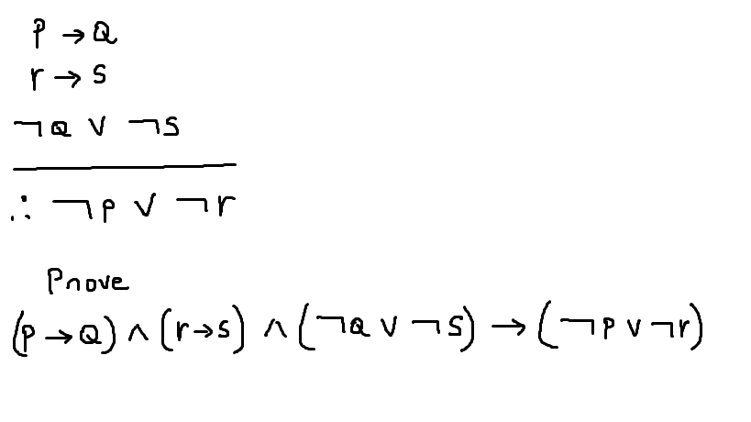
Destructive Dilemma – Disjunction of Modus tollens

Slide 61
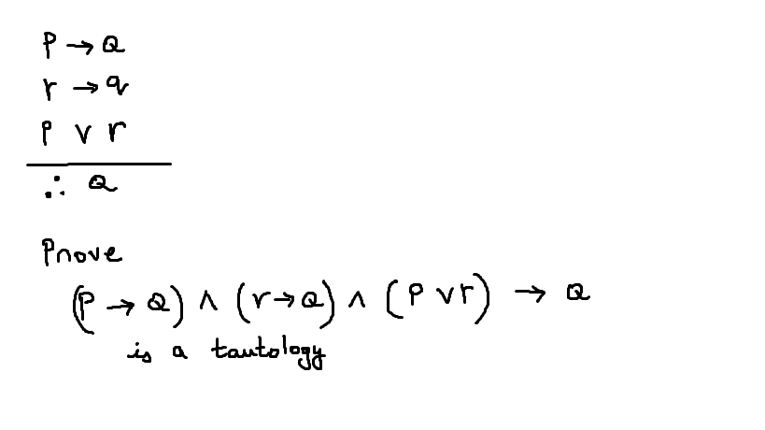
Proof by Cases

Slide 62
Proof - Contrapositive

Slide 63
contrapositive forms
Set the proposition P ----🡪 Q
Propose:
Not Q
.
.
.
Therefore,
Not P
Because P --🡪 Q is logically same as ( Not Q --🡪 Not P )

Slide 64


Slide 65

Useful example for contrapositive

Slide 66

contrapositive –Using truth tables

Slide 67

Contrapositive

Slide 68

Contrapositive

Slide 69
Contraposition
Prove for n integers, n² is odd when n is odd
P is n² is odd
Q is n is odd
Prove not Q implies not P
Q is not odd, Q is even. Can be expressed as 2k.
(2k)2 = 4k2 = 2.2.k2 = is even. n2 is even.
So our not Q -> not P implies p -> Q

Slide 70

Proof: Contradiction

Slide 71

Contradiction

Slide 72

Contradiction

Slide 73

Contradiction

Slide 74

Contradiction

